Slide 1
ENTITY RELATIONSHIP DIAGRAM

Slide 2
What is an ER Diagram?
ER diagram stands for Entity- Relationship Diagram
Used to define data elements and relationships specified for a system.
Develops conceptual design for a database.
E-R Diagrams are basically database structure portrayed in a diagrammatic manner.

Slide 3
Entities
Let us consider designing a database for a school. In a school, there are many people such as students, teachers, employees, etc. All these can be considered as entities in database terminology. Let us take an example of student entity.
An entity can be classified as any object, class, person or place.
In an ER diagram, entities are represented by a rectangle.

Slide 4
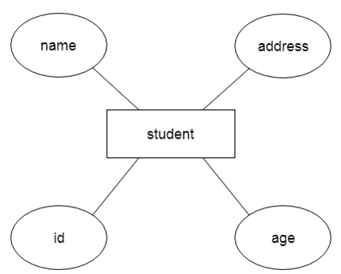
Example of an entity

Slide 5

Weak Entity
Weak entities are those entities that are dependent on another entity.
Weak entities are represented by double rectangle.

Slide 6
Attributes
Attributes are those that describes the property of an entity.
Attributes are represented by an ellipse.
Example: RollNo, Name, age, etc.

Slide 7
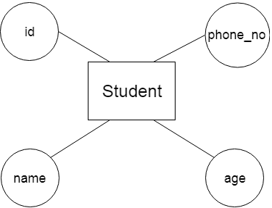
Example for attribute.

Slide 8
Key Attribute
Key attributes are those attributes that define the main properties of the entity.
The key attributes mainly represent the primary key.
It is represented by an ellipse with text underlined.
Ex: Id, SSN No, etc.

Slide 9
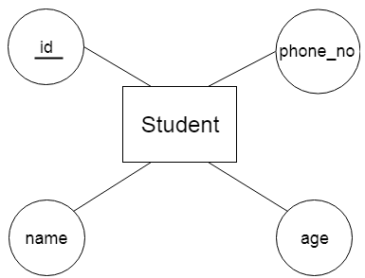

Slide 10
Composite Attributes
An attribute, which is composed of many other attributes, is called composite attribute.
It is represented by an ellipse which is connected to another ellipse.
Example: An attribute name can be divided into first name, middle name and last name.

Slide 11
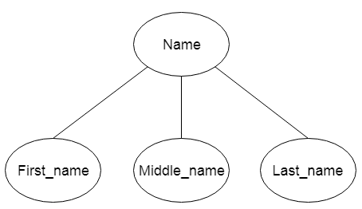

Slide 12
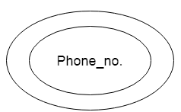
Multivalued attribute
An attribute may contain more than one values. Such kind of attributes are called as multivalued attributes.
Multivalued attributes are represented by double eclipse.
Ex: Phone Number, Email_Id etc.

Slide 13
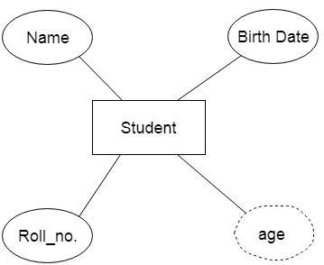
Derived attribute
An attribute which can be derived from another attribute is called as derived attribute.
Derived attributes are denoted using dashed ellipse.

Slide 14
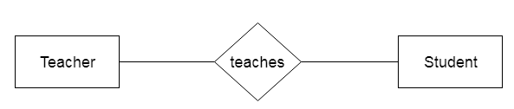
Relationships
Relationships are used to define the relationship between entities.
It is denoted by a Rhombus.

Slide 15
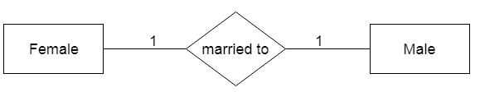
One-to-one relationship
If only one instance of an entity is associated with the relationship, it can be called as one-to-one relationship.

Slide 16
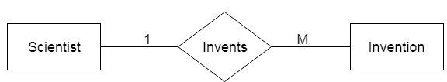
One-to-many relationship
If in a relationship, one instance from the entity is associated in a relationship with multiple instances of the right entity, it is said to be a one-to-many relationship.

Slide 17
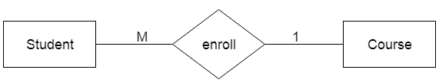
Many-to-one relationship
In many-to-one relationship, many instances of the left entity is associated in a relationship with one instance of the right entity.

Slide 18

Many to many relationship
In many-to- many relationship, multiple instances of the left entity is associated in a relationship with multiple entities on the right.

Slide 19
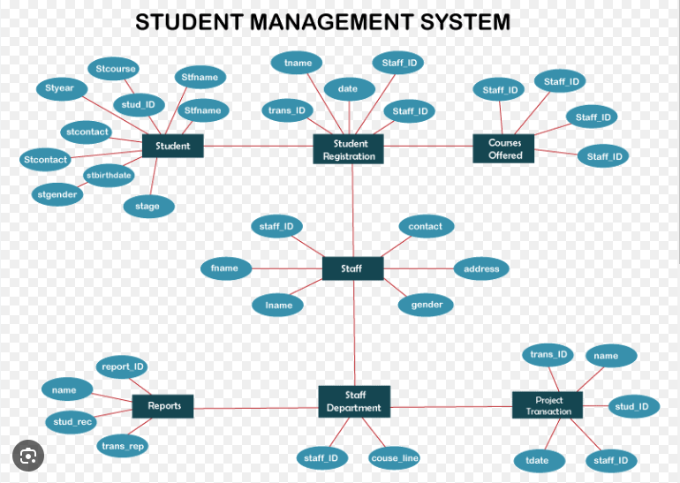
Sample E R Diagram

